Slide 1
Kubernetes (k8s) Introduction

Slide 2
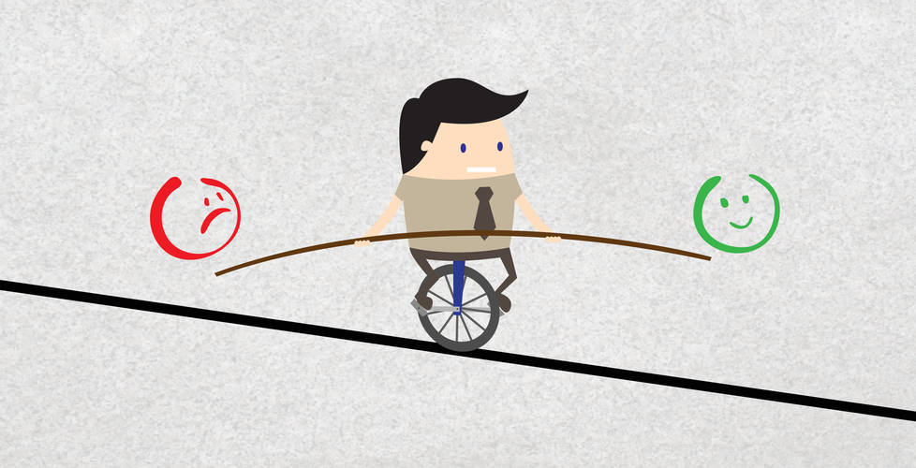
Balancing act
k8s Introduction
Slides
Code & Demo

Slide 3

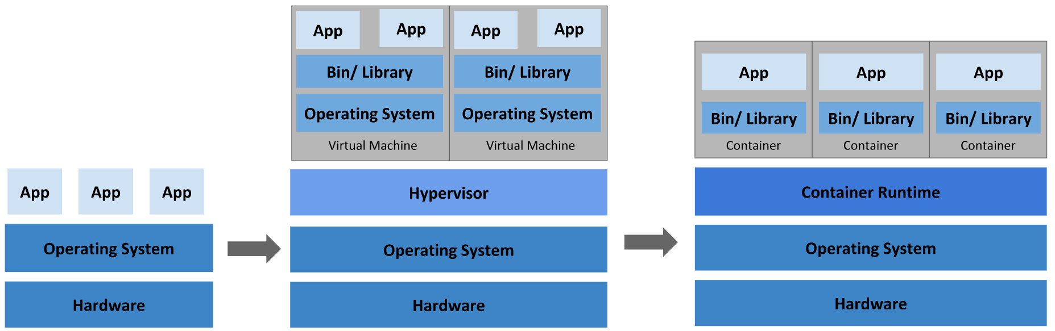
Going back in time
k8s Introduction
Bare metal
VM’s
Container orchestration platform
Ex: Docker Data Center
Notes:
Things are in the cloud. We still need to manage hardware, storage disks, static IP’s, Network complexity, Key and Certificates, other cloud resources!

Slide 4
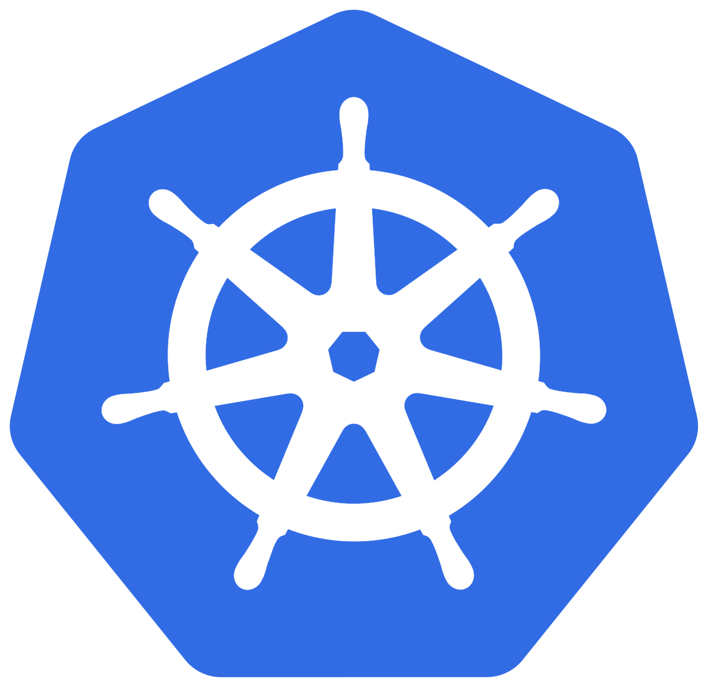
What is Kubernetes
k8s Introduction
Kubernetes (k8s) is an open-source container-orchestration system for automating application deployment, scaling, and management. It was originally designed by Google, and is now maintained by the Cloud Native Computing Foundation.
Planet Scale: Designed on the same principles that allows Google to run billions of containers a week.
Notes:
In nutshell, you can run your container applications.

Slide 5
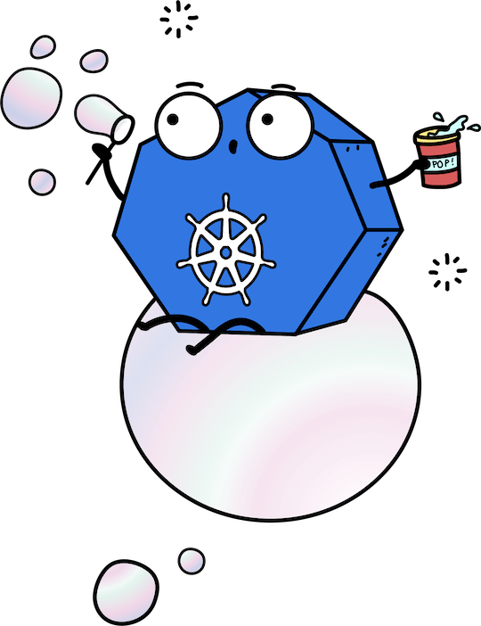
Kubernetes and what can it do
k8s Introduction
Service discovery and load balancing
Self-healing
Storage orchestration
Automatic bin packing
Horizontal scaling
Automated rollouts and rollbacks
Secret and configuration management
Batch execution
Notes:
Desired state.

Slide 6
Why you need know Kubernetes?
k8s Introduction
Built by Google and Contributed by all major company
One of the Fastest Growing Open Source Project and part of CNCF (Cloud Native Computing Foundation)
Available on all major cloud providers
Azure (AKS)
AWS (EKS)
GCP (GKS)
Runs on On-Prem or Cloud
Resource optimization
Vibrant community

Slide 7
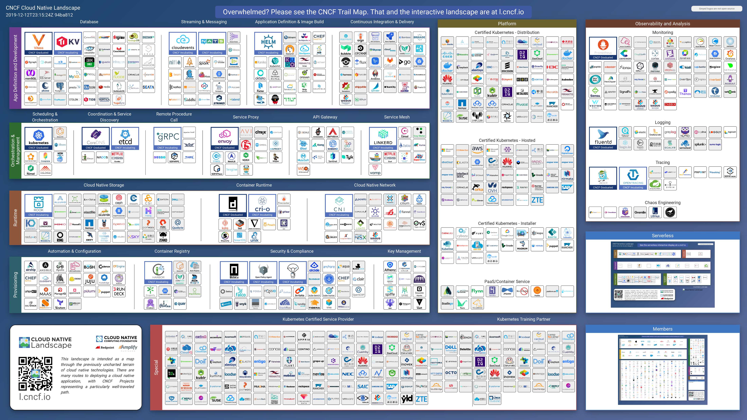
k8s Introduction
You are viewing 1,293 cards with a total of 1,957,229 stars, market cap of $14.77T and funding of $63.74B.

Slide 8
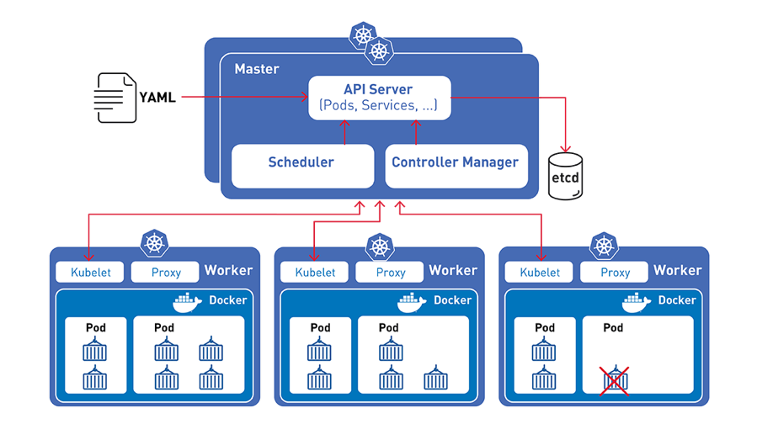
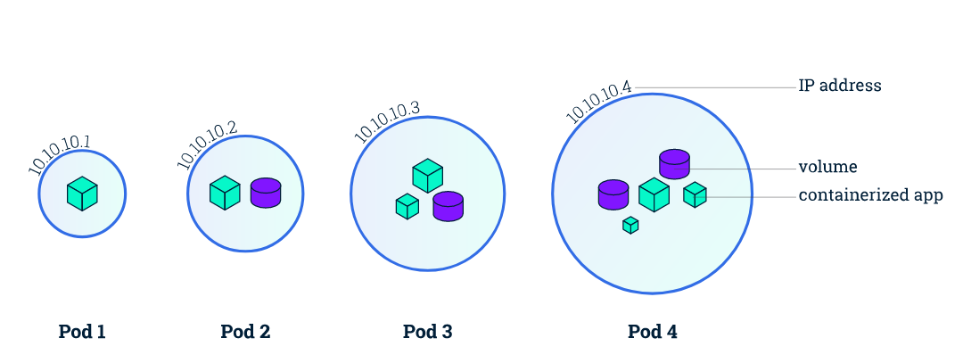
Kubernetes Components - Pods
k8s Introduction
Notes:
Constantly trying to reach it’s desired state.

Slide 9
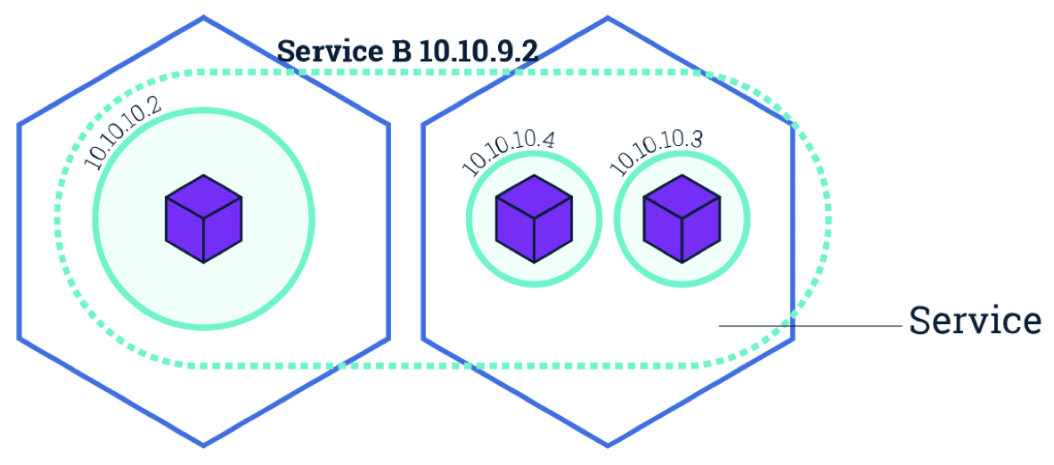
Kubernetes Components - Service
k8s Introduction

Slide 10
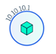
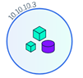
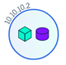
Kubernetes Components - Service
k8s Introduction
foo
Service
/foo
Internet
Ingress
/bar
ber
Service
abc.def.com
abc.def.com
Service

Slide 11
Code
k8s Introduction
http://hostname/
{
"msg": "Hello World!",
"serverTime": "2019-12-13T02:13:18.112Z",
"hostname": "hello-world-6c5fb5d4d8-nnwc6" // Machine name
}
http://hostname/theme
{
"themeValue": "Orange", // “theme” value from environment variable
"serverTime": "2019-12-13T02:15:07.224Z"
}
http://hostname/kill // Kills the application, crash
Docker Image: docker pull priyakant/hello-world-web-app
https://hub.docker.com/r/priyakant/hello-world-web-app

Slide 12
Kubectl - cli
k8s Introduction
# get nodes
kubectl get nodes
# get pods
kubectl get pods
# get service
kubectl get service
# deploy
kubectl apply -f ./deploy-all.yaml
# delete deployment
kubectl delete -f ./deploy-all.yaml

Slide 13
Reference
k8s Introduction
Tutorial | https://kubernetes.io/docs/tutorials/ https://www.katacoda.com/courses/kubernetes
Kubectl cli | https://kubernetes.io/docs/tasks/tools/install-kubectl/
Source code | https://github.com/priyakantpatel/intro-k8s

Slide 14
Questions?

